Slide 1
Conference on 100 Smart Cities : Vision for Smart India

Slide 2
A Step Towards Fulfilling the Dreams of Hon’ble Prime Minister Shri Narender Modi

Slide 3
Inaugurated by Sh. Shankar Aggarwal Secretary, Ministry of Urban Development

Slide 4
Supported By Ministry of Urban Development Govt. of India

Slide 5
Organized by
Knowledge Partner

Slide 6
CSR Research Foundation
A non-profit organization registered under Section 25 of The Companies Act. 1956
Standing for knowledge dissemination and facilitating corporate in fulfilling their Corporate Social Responsibilities.
Provides effective information on latest developments in different tools, techniques and applications to bring balance between economic, environmental and social imperatives through researches, seminars, symposiums, lectures, workshops, conferences, etc.

Slide 7
MSN Infrastructure & Financial Consultants Limited
A multi-disciplinary consulting organization in blue and green domain creating opportunities and providing transaction advisory, concessions, project management, project financing, training & capacity building services.
Associated with numerous municipal corporations, state governments, developers, investors , financial institutions, multilateral funding agencies, corporate and multinationals.

Slide 8
GUEST SPEAKERS

Slide 9
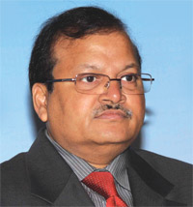
He is Secretary in the Ministry of Urban Development. He has 35 years of experience in housing and urban development, IT, finance, energy, technical education, small-scale industries, transport and defense.
Shankar Aggarwal, IAS

Slide 10
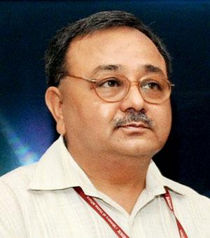
He is Secretary in the Ministry of Water Resources. He has held diverse assignments in his 30 years of rich administration in diverse sectors including the road transport, highways, Defense, urban planning and development etc.
Alok Rawat, IAS

Slide 11
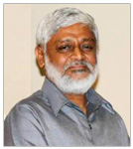
He is Director of DDF Consultants Pvt. Ltd. Is an IIT Roorkee alumnus and has worked in India and abroad in diverse fields, ranging from teaching and research to development planning, policy planning and disaster management.
Prof. Amit Bose

Slide 12
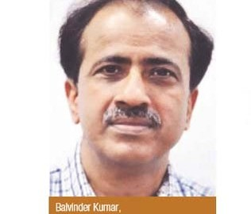
He is Vice Chairman Delhi Development Authority (DDA) and former Chairman of Noida Authority, has been instrumental in creating world class infrastructure in urban domain.
Balvinder Kumar, IAS

Slide 13
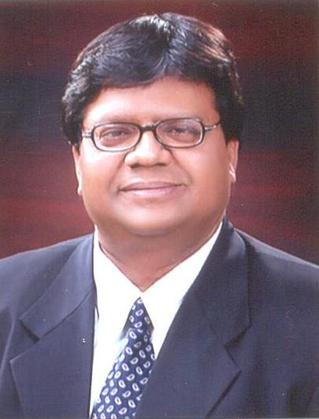
He is Chairman - CSR Research Foundation, Secretary -Delhi Chapter IGSI, Director Hindustan Smachar, National Co-Convener BJP CA Cell, Chairman- Intellectual Federation of India and former Member -NIRC of ICAI.
CA Deendayal Agrawal

Slide 14
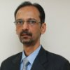
Dr. Devendra Kumar Pant
He is the head of India Ratings' public finance practice. His primary areas of expertise are economy, State and municipal finances, and state- and sovereign-owned entities and PSUs.

Slide 15
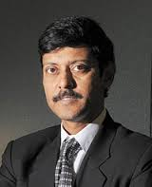
He is CEO of Value Research. He is an expert in Investment and Financial Advisory Services, Equities, Capital Markets, and Equity and Investment Research.
Sh. Dhirendra Kumar

Slide 16
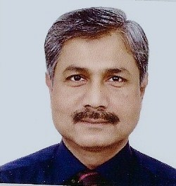
He is a retired Indian Service officer who had a long stint with the Government of India as Director General, DAVP and Director General (News), All India Radio, Spokesperson of CBI. Currently a practicing advocate and an attorney
Giridhari Mohanty, IIS ( Retd.)

Slide 17
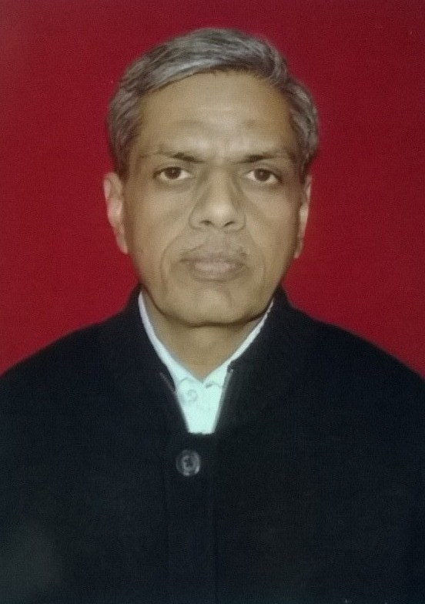
He is Secretary Jaladhikar a NGO working in water conservation, Secretary -Sampooran Parivartan and contributor of a weekly article on tax advisory in Hindustan (Hindi).
CA Kailsh Chandra Goduka

Slide 18
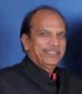
He is a professor at Indian Institute of Public Administration. His area of expertise includes Urban Governance and Management, Institutional Development and Capacity Building, Urban Housing, PPP and Urban Infrastructure Finance.
Dr K.K. Pandey

Slide 19
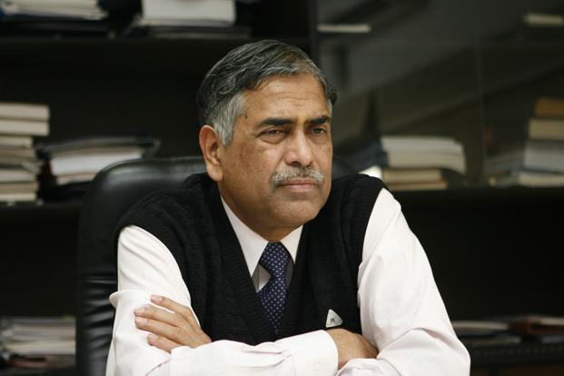
He is the former Secretary Ministry of Civil Aviation, former Special Secretary and Financial Adviser in the Ministry of External Affairs. He has wide experience in the field of civil aviation.
K.N. Srivastava, IAS (Retd.)

Slide 20
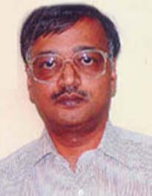
He is Deputy Director General, National Informatics Centre, Department of Electronics & Information Technology, Ministry of communication & IT, Govt. of India.
Dr. Mahesh Chandra

Slide 21
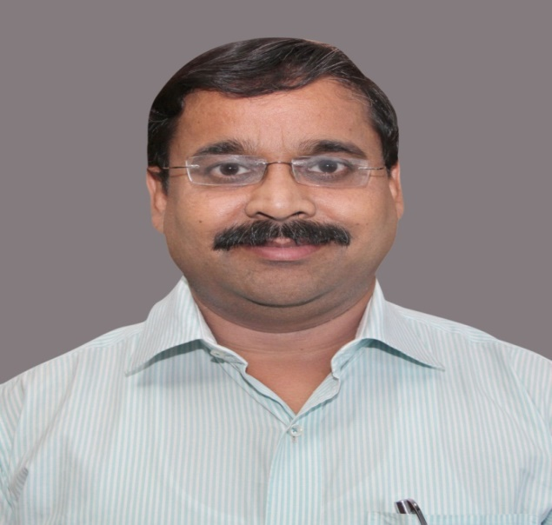
He is Commissioner of South Delhi Municipal Corporation. He brings with him a rich administrative experience spanning an eventful career of 20 years in important positions in Government of India, Delhi Government and other State Government.
Manish Gupta, IAS

Slide 22
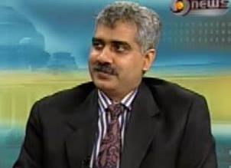
He is Managing Director Augtics Systems & Services Pvt. Limited, an IIT Roorkee & Delhi Aluminous, a Water Resources, Urban Infrastructure and GIS expert.
Manoj Misra

Slide 23
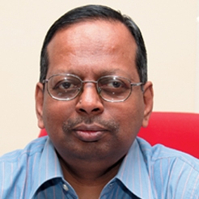
He is Secretary, Ministry of Personnel, Public Grievances & Pensions and Department of Administrative Reforms & Public Grievances.
N. Ravi Shankar, IAS

Slide 24
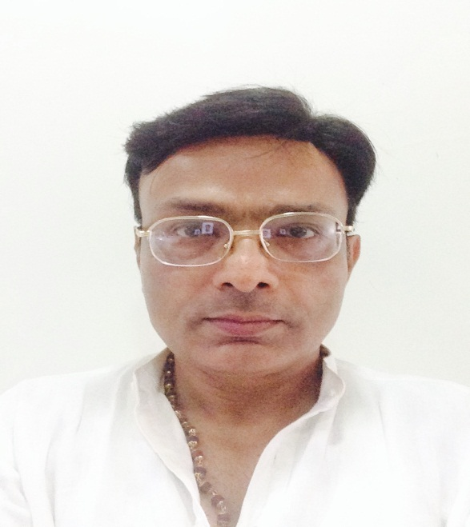
He is working with Govt. of NCT, former Member (Admin) NHAI. He has been instrumental in formulation of Industrial Policy, New Excise Policy, streamlining the functioning of Old Age Pension Scheme, MLA Fund Scheme etc.
Narendra Kumar, IAS

Slide 25
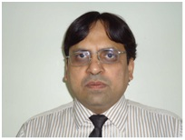
He is Head-Regulatory Affairs-Climate in URS Verification Pvt. Ltd having 17 years of experience in Regulatory body, Environmental and Climate Change etc.
Naresh Badhwar

Slide 26
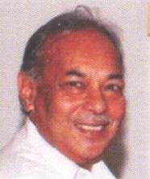
He is the former Commissioner of Azamgarh, Uttar Pradesh, presently General Secretary International Goodwill Society of India, promoting peace through international goodwill and national harmony.
Dr. R K Bhatnagar, IAS (Retd.)

Slide 27
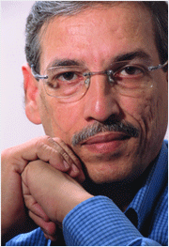
He is the Director of MSN Infrastructure & Financial Consultants Ltd., is a PPP Expert in urban infrastructure domain funded by Central Government, States, ULBs, ADB, Word Bank, JAIC and other multilateral funding agencies.
CA Sudhir Malik

